Slide 1
Paper Review on:
Modelling Population Growth, Shrinkage and Aging using a Hybrid Simulation Approach: Application to Healthcare
Bożena Mielczarek and Jacek Zabawa
Submitted by:
Tasfia Anika Bushra (23166013)

Slide 2
Introduction
Demographic forecasts are crucial for various economic studies as demographic changes impact economic growth, social security, urban development, and health policy.
Accurate population structure replication is essential for long-term implications.
Two main approaches are followed: deterministic projections and stochastic forecasting.
Stochastic forecasting involves time series modeling and accounts for demographic uncertainty.
Stochastic sub-models use Monte Carlo (MC) simulations to predict population distribution.
Another well-known simulation methodology utilized to capture the population evolution is System Dynamics (SD).System Dynamics (SD) provides a different approach for modeling and analyzing dynamic systems.
MC simulations focus on individuals to produce forecasts, while SD models formalize mental models and explore system behavior.
Simulation Methodology
MC Simulations
System Dynamics
Focus on Individuals to produce forecast
Formalize Mental Models

Slide 3
1.1. Motivation and Goal
The motivation of the study came from the thought that demographic forecasts are crucial for various economic studies as demographic changes impact economic growth, social security, urban development, and health policy.
The overall goal of the study is to build a hybrid simulation model that would allow alignment of short-term demographic forecasts with health policy models to predict the future demand for healthcare services.
The hybrid simulation model aligns short-term demographic forecasts with health policy models.
Input parameters are calculated based on forecasted demographic rates.
The model distinguishes individual patients and records their movements.
The goal is to validate the approach using the System Dynamics method.
The model allows for adjusting the time step in response to feedback from the discrete module.

Slide 4
1.2. Contribution
Research Objective: The primary goal of the researchers is to validate the System Dynamic method pioneered by Forrester in 1968.Their contribution can be segmented into two separate parts:
Methodological Focus: The research will specifically explore the credibility of the approach and delve into the intricacies of the System Dynamic method as it pertains to the modification of the time step (dt) within the population module.
Adaptive Framework: One notable aspect of their contribution lies in developing a framework that allows for the dynamic adjustment of the time step (dt) based on feedback received from the discrete module, showcasing a commitment to enhancing the adaptability and responsiveness of the overall system.

Slide 5
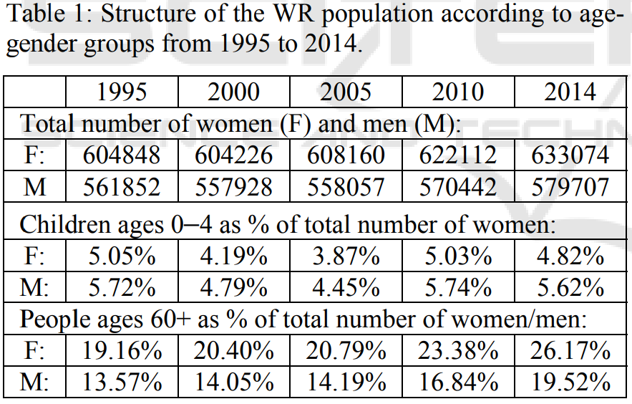
Population of Interest (dataset)
Population of interest focuses on two subregions in Lower Silesia, Poland.
These subregions are referred to as the Wrocław Region (WR).
WR includes nine administrative districts, including the capital city, Wrocław.
Data from the Central Statistical Office (GUS, 2015) shows an annual increase in the total population of the WR for both genders.

Slide 6
1.3. Model Description and Methodology
Built on Eberlein et al.'s (2011) aging concept.
Initial version by Mielczarek et al. (2014).
System Dynamics notation depicts aging chains.
Ten state variables represent cohorts.
Input/output flows ensure accurate simulations.
Initial population data from 2002, runs until 2014.
Beyond 2014, parameters extrapolated from CSO forecasts (Waligórska et al., 2014)
The computer model used here has the following specifications:
ExtendSim model with DES and SD submodels.
Over 700 hierarchical blocks.
SD simulates population evolution; DES generates healthcare events.
Time control by discrete DES module.
Database manages parameters and simulation data.

Slide 7
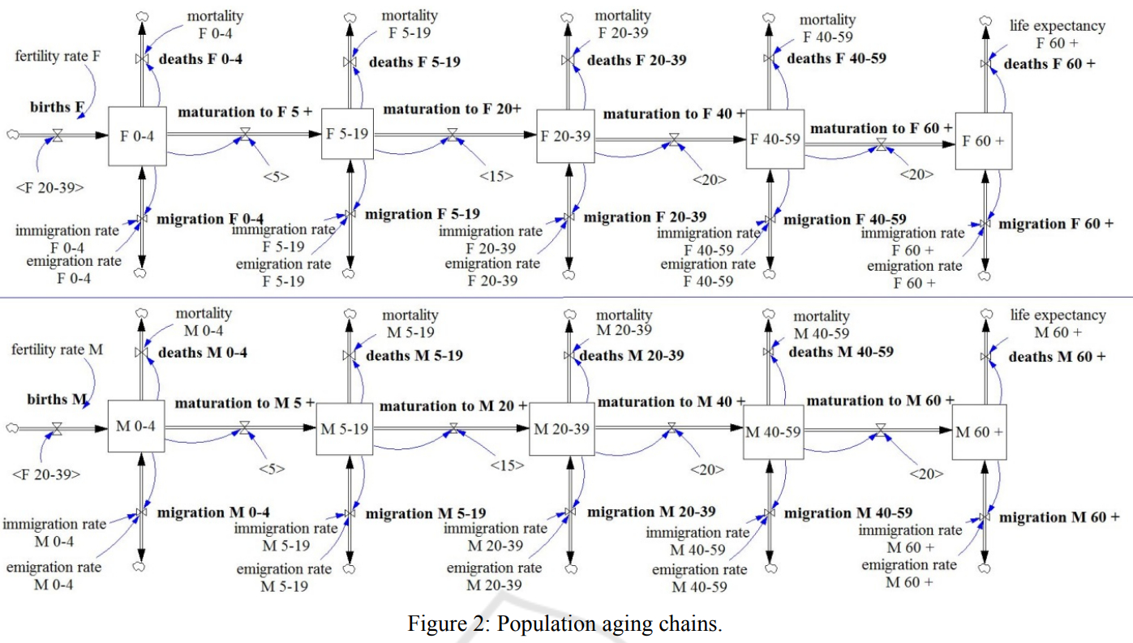
1.3. Methodology - Population Aging Chains

Slide 8
1.3. Methodology - Cohorts
Cohorts F 0−4 and M 0−4:
Influenced by births, immigration, maturation, deaths, and emigration.
Births tied to female 20−39 cohorts, migration to/from Wrocław Region.
Deaths based on youngest citizens' death rates.
Maturation reflects transition to older cohorts.
Since 2015, uses hypothetical rates from projection scenarios.
Cohorts 5−19, 20−39, 40−59:
Represent population aged four to 60.
Involve maturation from the previous cohort.
Cohorts F 60+ and M 60+:
Represent oldest population.
Involve maturation, immigration, emigration, and deaths.
Deaths calculated based on average life expectancy at 60.
Historical values estimated till 2014; from 2015, hypothetical values from different projection scenarios.

Slide 9
1.3. Methodology - SD-DES Time Mechanism
SD Modeling Approach:
Uses differential equations for dynamic system observation.
Suited for continuously changing systems.
Demography Studies:
Prefers discrete intervals for capturing births and deaths.
Time-step mechanism assumes constant discrete values.
Dynamic Object Aggregation:
Input and output flows instantly update cohort sizes.
Healthcare System Demand:
Parameterizes inter-arrival time distributions using values from holding tanks.
DES Model Integration:
Discrete objects seamlessly enter DES model without delay.

Slide 10
1.3. Methodology - Simulation Experiment - Scenario
The model assumptions for simulation beyond 2015 include:
A slight decline in fertility rates for the next few years, followed by a gradual increase. In 2035, an expected 20.0% increase for males and 22.0% for females.
Gradual increase in death rates from 2015 to 2035, except for middle-aged cohorts (M 40–59 and F 40–59), where a slight decline is anticipated.
Stable life expectancy differences between Poland and European countries for the next 20 years. In 2035, a woman aged 60 is projected to live an average of 27.75 years, and a man of the same age, 24.27 more years.
An alignment trend between emigration and immigration, with international and internal net migrations expected to decrease to nearly zero by 2035, reducing the total number of immigrants and emigrants by approximately 20%.

Slide 11
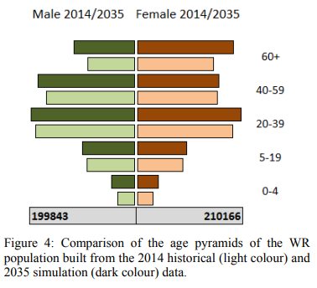
Simulation Experiment - Result Analysis
Population forecasts for ten distinct age cohorts (male and female) align with CSO predictions.
The irreversible aging trend will raise the old-age rate from 18.84% in 2014 to 22.17% in 2035.
The median age will reach around 50 in 2035, reflecting a significant aging pattern.
Females are expected to surpass males by over 10%.
A minor decline in the number of children aged 0–18 is anticipated for 2035 compared to 2014.

Slide 12
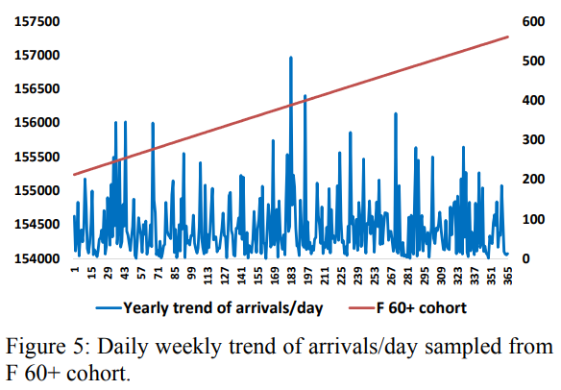
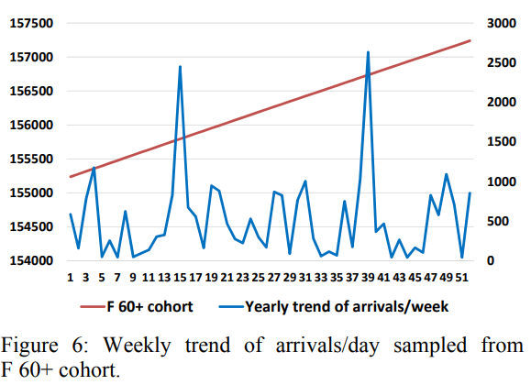
Simulation Experiment - Result Analysis
Figure on the left and right present selected output generated by the System Dynamics (SD) module and directed to the Discrete Event Simulation (DES) module.
The upper line in these figures represents the stock level for the total count of females aged 60 and over, spanning the years 2014 to 2016.
This stock level is translated into a flow of patients arriving at the healthcare system, as shown in the lower line.
The "blending problem," where individuals become indistinguishable in large populations, is addressed by modeling the discrete volume of healthcare needs specifically for women aged 60 and above in the Wrocław Region.
These figures showcase the convergence of two perspectives: long-term population evolution projection based on aggregated data (upper line) and the discrete arrival of individuals at the healthcare system (lower line).
The approach provides flexibility in modeling the arrival process, enabling versatile analysis of healthcare demand.
The figure on the left focuses on the number of female patients aged 60 and over arriving at healthcare units, utilizing daily sampling.
The figure on the right focuses on the same demographic but employs a weekly sampling approach, demonstrating the system's modeling adaptability.

Slide 13
1.4. Conclusion
The future work in this area can focus on the following aspects:
Enhancing the Aging Chain Population Model
Modeling Morbidity Trends and Uncertainty
Incorporating External Factors: Explore the inclusion of external influences in the model, such as economic growth, educational development, etc.
Solving Technical Challenges: Address technical challenges related to integrating modules driven by different simulation paradigms, focusing on optimizing simulation run times, etc.
Further Comprehensive Studies: Expand the scope of research to conduct more comprehensive studies in this field.
In conclusion, the integration of System Dynamics and Discrete Event Simulation shows promise, and future research can build upon this foundation to enhance our understanding of how changing demographics impact healthcare demand and resource allocation.

Slide 14
2. Limitations
Technical Constraints: A 25-minute duration for a single simulation run poses challenges, especially for stochastic simulations that need multiple replications. This constraint limits the study's scope and efficiency.
Incomplete Model Calibration: Despite precise total population simulation, specific cohorts require additional calibration, introducing uncertainty and potentially affecting the model's accuracy. Further refinement of the aging chain population model is needed for a fully calibrated simulation.

Slide 15
2.1. First Limitation/Critique
Technical Constraints:
Prolonged time frame: Approximately 25 minutes per simulation run.
Significant technical hurdle, especially for stochastic simulations requiring multiple replications.
Limits expeditious execution, posing challenges in computational resources and time management.
Impedes the exploration of diverse scenarios, diminishing study thoroughness and comprehensiveness.

Slide 16
2.2. Second Limitation/Critique
Incomplete Model Calibration:
Cohort Calibration Limitation:
Incomplete calibration of specific cohorts.
Implies imprecise representation of certain demographic segments.
Introduces uncertainty in model accuracy.
Crucial Need for Refinement:
Additional refinement and testing of aging chain population model needed.
Lack of full calibration poses a risk of imprecise demographic projections.

Slide 17
3. Synthesis
Future Scope
Model Enhancement: Refine the aging chain population model for precise demographic simulations.
Morbidity and Uncertainty: Develop robust methods for modeling morbidity trends, addressing uncertainty.
Incorporating External Factors: Integrate economic growth, education, and socio-economic factors for a more realistic model.
Technical Problem-Solving: Overcome challenges in integrating diverse simulation modules and optimize run times.
Scope Expansion: Extend research for a more comprehensive understanding of population dynamics and external influences.

Slide 18
References
GUS, 2015, Główny Urząd Statystyczny. Available: www.stat.gov.pl [December, 2015]
Waligórska, M., Kostrzewa, Z., Potyra, M. and Rutkowska, L., 2014. Population projection 2014- 2050. CSO, Demographic Surveys and Labour Market Department.
Lisenkova, K., Mérette, M. and Wright, R., 2013. Population ageing and the labour market: Modelling size and age-specific effects. Economic Modelling, 35, pp. 981-989.
Lutz, W., Sanderson, W. and Scherbov, S., 2001. The end of world population growth. Nature, 412(6846), pp. 543-545.
Masnick, K. and Mcdonnell, G., 2010. A model linking clinical workforce skill mix planning to health and health care dynamics. Human Resources for Health, 8(1), pp. 11.
Mielczarek, B., Zabawa, J. and Lubicz, M., 2014. A system dynamics model to study the impact of an age pyramid on emergency demand, M.S. Obaidat, J. Kacprzyk and T. Oren, eds. In: SIMULTECH 2014 - Proceedings of the 4th International Conference on Simulation and Modeling Methodologies,

